Slide 1
A Distributed Solver for Linear Equations
By: Christopher Sweeney

Slide 2
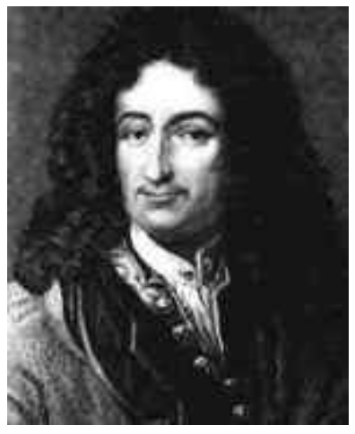
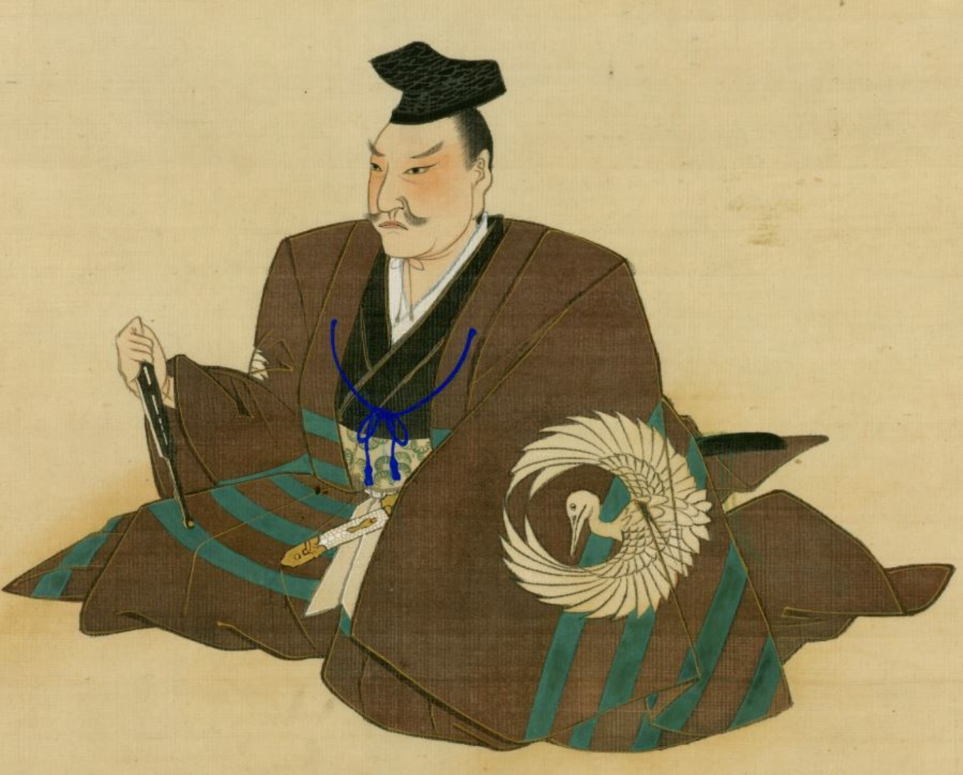
A History of Linear Equations
Gottfried Leibniz (1646-1716) - German polymath of mathematics, philosophy, science, and politics
Arranged the coefficients of a system of linear equations to find the solution(s) -
Later developed by German mathematician Gauss (1777-1855)
in the West - Japanese mathematician Seki Takakazu (1642-1708) developed it in the East

Slide 3
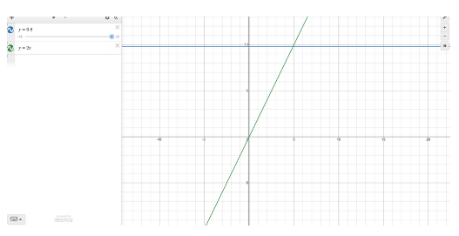
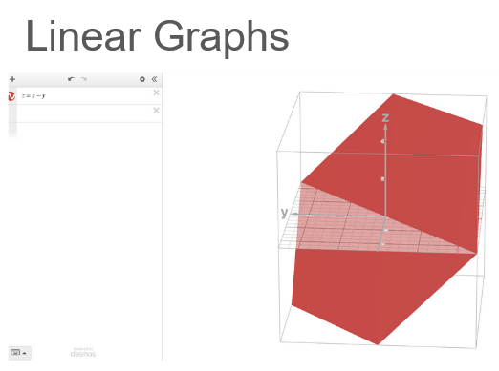
What are Linear Equations?
A system of equations with variable of degree one
Acts a linear mapping, or transformation
Presented in the form Ax=b
A in the linear system
x is an observed vector space
b is the resulting vector space after linear transformation
Contrasts with radical, quadratic, cubic, and higher/lower order functions
Applications in various fields of research, computing and machines

Slide 4
Linear Systems in Action
Transformations, isomorphisms
Beamforming, error correction
Massive MIMO
Time-series data
Production monitoring, reporting
Token embeddings, weights
Computer vision, graphics
Wireless networking (5G, IoT)
Radio arrays
HF trading, Folding@Home
Smart manufacturing/cities
LLMs and neural networks

Slide 5
Common Algorithms to Solve Linear Equations
Square Matrices (m=n)
Gaussian Elimination (Chen)
LU Decomposition
Sparse
Sparse LU
Conjugate Gradient
Under-determined (m<n)
Pseudoinverse
Minimum Norm (O(n²⁻³) !!!
Kaczmarz's Algorithm (Stack)
Ill-conditioned
Regularization
SVD
Over-determined (m>n)
Least Squares
SVD

Slide 6
Solving with a Distributed Algorithm
Distributing workload allows for:
Larger linear systems, scalability
Parallelism
Increased capabilities, with trade-offs:
Bandwidth and latency
Fault tolerance
Higher initial costs, except when hardware limited (Oltafi-Saber)

Slide 7
Solving with a Distributed Algorithm
Server sets up a linear system for clients to guess the solution
Clients send guesses, receive feedback and neighbors’ guesses
Clients race to and quickly converge on solution, finishing the “game”

Slide 8
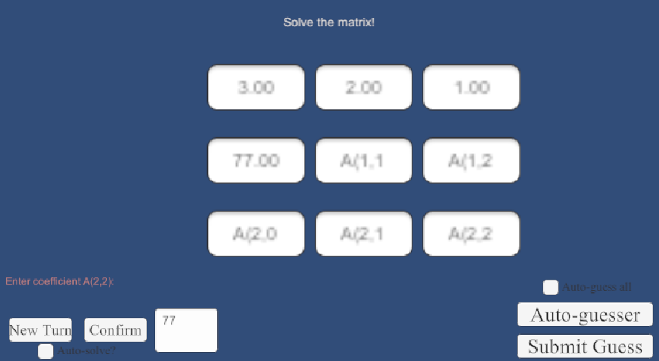
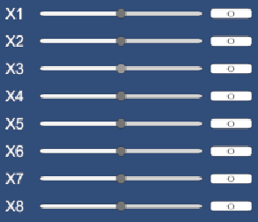
Program Control Flow
Server sets up A and x, calculates b
Clients guess by moving sliders and send to server

Slide 9
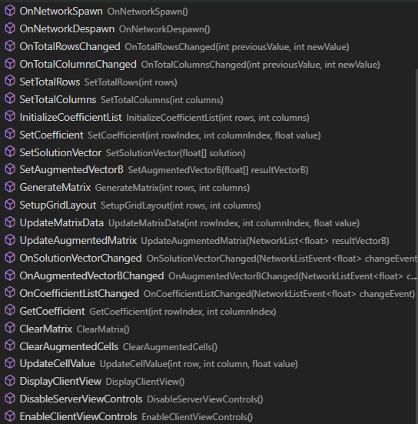
Matrix Network Object
Handles “game board”
Shared between server and all clients
Attributes public except for the NetworkList<float> solutionVector

Slide 10
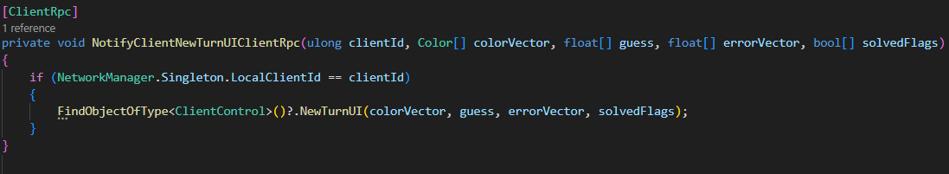
Server Setup
NotifyClientsAutoGuessChangedClientRpc
NotifyClientsMatrixSetupCompleteClientRpc
NotifyClientNewTurnUIClientRpc
NotifyClientsWinnerClientRpc
NotifyNeighborsClientRpc
NotifyClientNeighborGuessesClientRpc

Slide 11
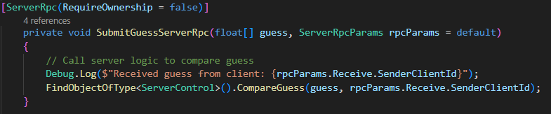
Client Networking
ClientCanvas Network Object
ClientRPCs in ClientControl script:
OnMatrixSetupComplete()
NewTurnUI()
OnWinnerAnnounced()
SetNeighbors()
UpdateNeighborGuesses()
ServerRPCs in ClientControl script:

Slide 12
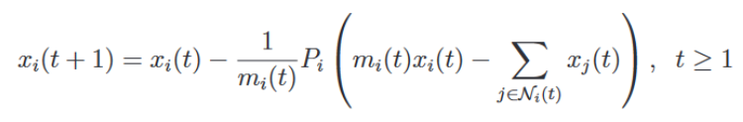
Adapting an Optimized Algorithm to use with Unity
The chosen method is based on work from Mou, Lio, and Morse:
Client’s guess
Client’s guess
Projection parameter
Neighbor’s guess
Number of neighbors

Slide 13
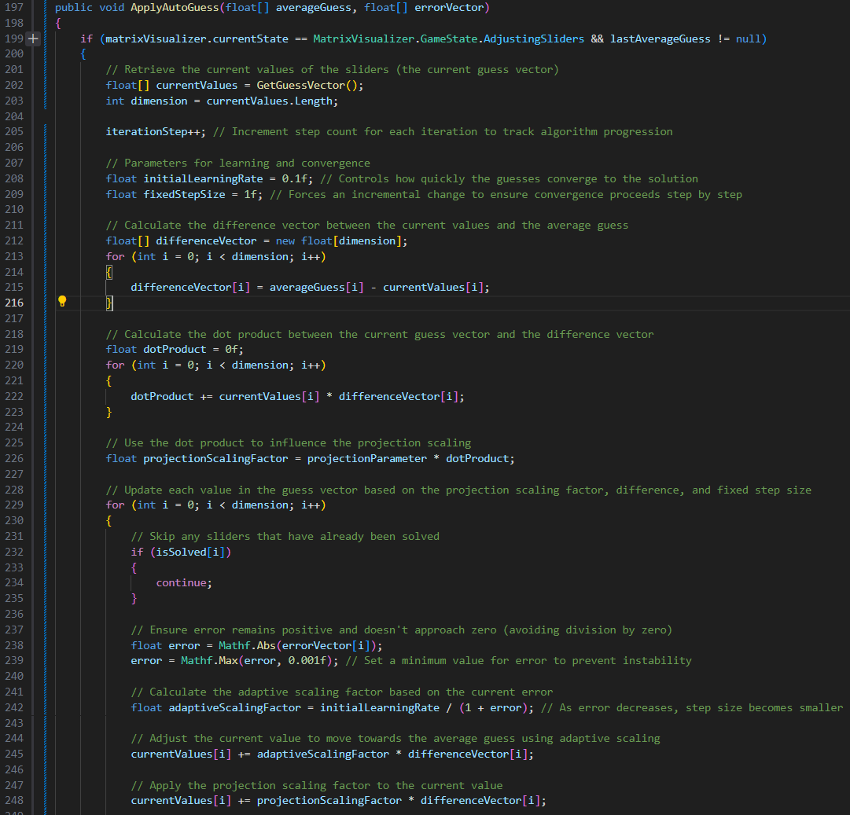
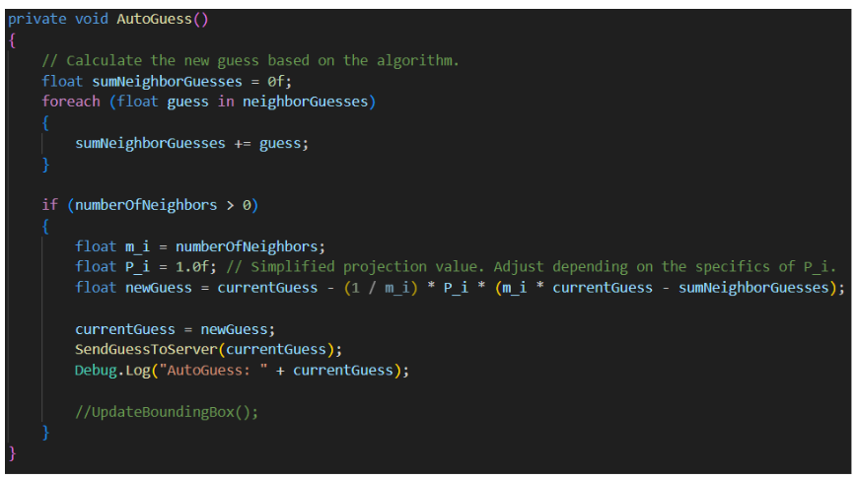

Slide 14
Dual Algorithmic Convergence
Distributed algorithm relies on differentiated clients
Solution known, so cost function is used
Gradient descent optimization + signal averaging (Chong 231)
Faster server would speed up former
More/faster clients would speed up latter

Slide 15
Distributed Difficulties
Network Objects require serialization, some types need custom
Host/Server ambiguity and lots of gates
Handing control flow to clients and back to server can get stuck
Slider behavior is erratic, disturbs algorithm
Lots of listeners and clamping
Neighbor assignment easy, neighbor guess handling is hard

Slide 16
Extending the Solver
Building nearest neighbor graph to visualize algorithm
Allow real-time matrix manipulation, just like sliders
Neighbor strategies and network topology templates
Piping in linear system – home automation, PID, wireless
Matrix randomization, schemas, lessons

Slide 17

Works Cited
Mou, S., Lio, J., & Morse, A. S. (10/03/2024). A distributed algorithm for solving a linear algebraic
equation. Retrieved from https://arxiv.org/pdf/1503.00808
Olfati-Saber, R., Fax, J. A., & Murray, R. M. (2007). Consensus and cooperation in networked multi-
agent systems. Retrieved from https://labs.engineering.asu.edu/acs/wp-content/ uploads/sites/33/2016/09/Consensus-and-Cooperation-in-Networked-Multi- Agent-Systems-2007.pdf
Stack Overflow. (n.d.). Computational intensity of transposing a matrix vs. calculating the inverse. Retrieved November 27, 2024, from https://stackoverflow.com/questions/7446389/computational -intensity-of-transposing-a-matrix-vs-calculting-the-inverse
Chen, X. (n.d.). Kaczmarz Algorithm, row action methods, and statistical learning algorithms. Iowa State University. https://faculty.sites.iastate.edu/esweber/files/inline-files/KaczmarzSGDrevised.pdf
Chong, E. K. P., & Zak, S. H. (2013). An introduction to optimization (4th ed.). Wiley.

